Slide 1
Computer Science Department
Capstone Project
CSC 521
2022
Prediction of Customer churn in a Bank
By SAMUEL KAWUMA
CSC 521 Project Supervisor
FATEMA NAFA

Slide 2
Contents
Student Objectives
Problem Specification
Amendments
Solution Process and Design
Requirement Collection and Analysis
High level Architectural Diagram
Methodology
UI Mockups
Benchmark Specification
Tool List
Schedule Grading Scheme for CSC521
Deliverables
References

Slide 3
Student Objectives
To enable me to integrate the knowledge I have gained as a result of pursuing my computer science degree program in college.
To integrate the skills and concepts learned systematically during my semester
To integrate all aspects of the course which includes the theory, practical skills, and communication skills.
To combine the diverse skills acquired in class and apply them work environment..
My Capstone project should, therefore, focus on helping me to perfect technical skills in handling a given task. This requires me to have hands-on experience in the fields of specialization that I have chosen to undertake

Slide 4
Analyze private data of Bank Customers with goals to discover key insights from the bank customers database and study the customers’ demographics such as customer (gender, age, and location).
Understand the company’s product and customer’s financial history such as customer (credit score, estimated salary, balance, tenure, credit card possession, etc.).
Understand how variable such as customers demographics and financial history affects the customers churn rate.
Perform analysis and developing a prediction model for the bank customer churn.
Project Specification

Slide 5
Originally my project was to specifically focusing on visualization, but then I had to go further and predict whether a customer will leave a bank or not.
I used several libraries that I didn’t use in my proposal
Amendments

Slide 6
Solution Design
Requirements and Analysis
Stake holders
Banks
Since customers are the most valuable assets of most banking institutions,
It is advantageous for banks to know what leads a client towards the decision to leave the company
Churn prevention allows companies to develop loyalty programs and retention campaigns to keep as many customers as possible.

Slide 7
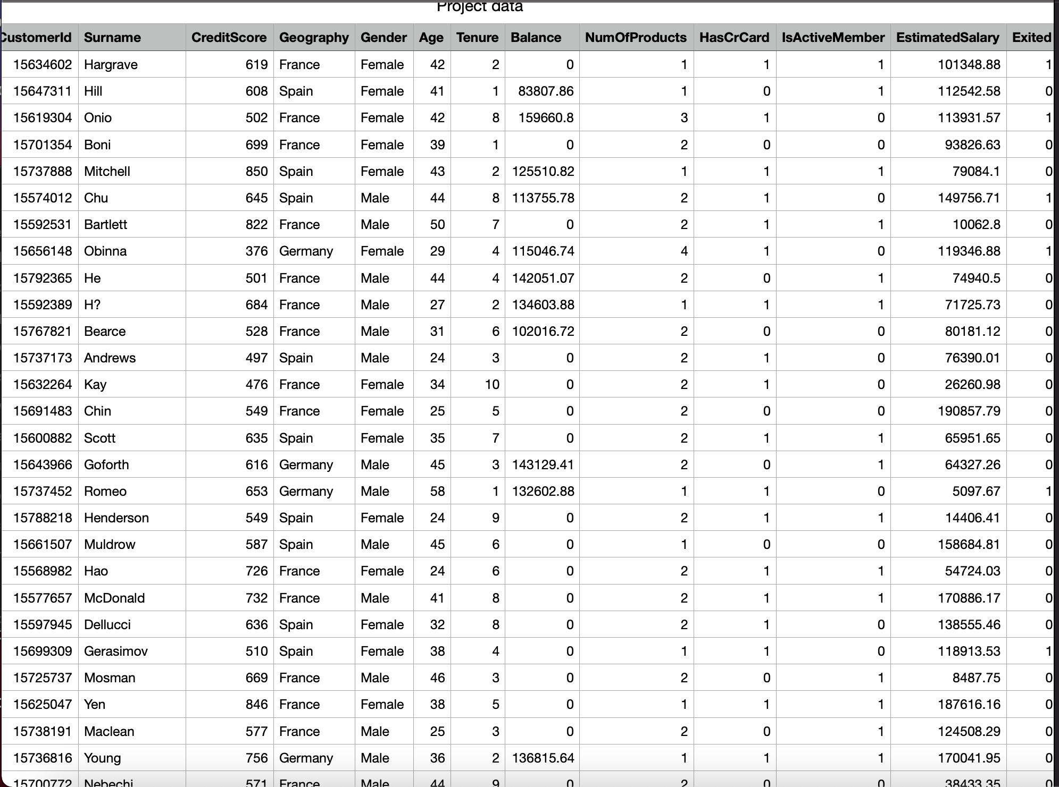
Dataset And Features
The input to the application is a .csv file served as the raw data for the application.
The raw data consists of many attributes.
Here is a screenshot of the titles of the .csv file.

Slide 8
High Level Architecture Design

Slide 9
In this project I will use CRISP-DM to build the bank customer churn prediction model in this methodology , a 5– phase technique was used ;
Data Collection
Data Understanding
Data Preprocessing
Modelling and Evaluation
Model Deployment
Methodology

Slide 10
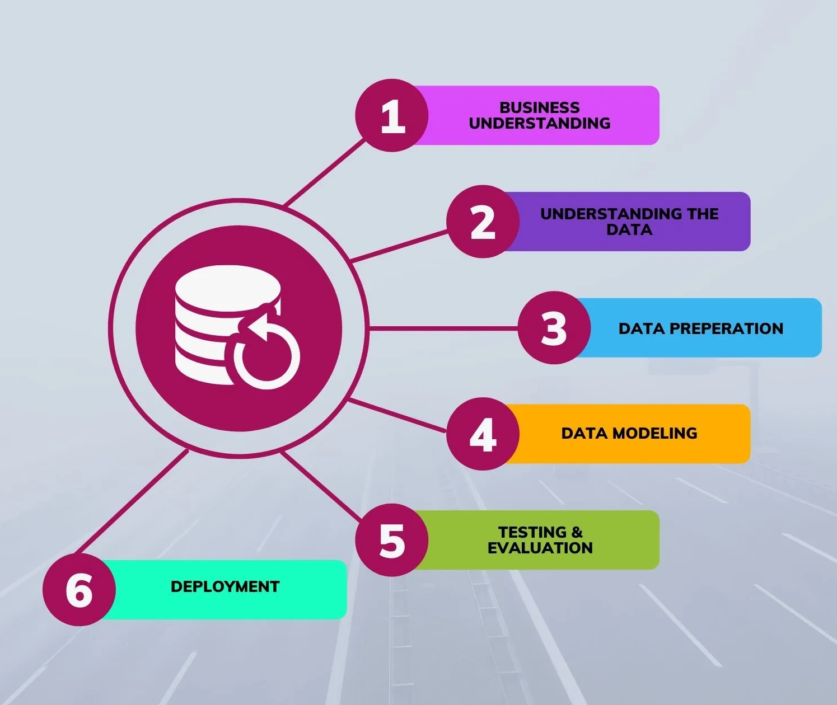
Methodology

Slide 11
1.Data Collection
Methodology
The data used in the project to perform the analysis and predictive modelling of bank customer churn was sourced from Kaggle.

Slide 12
2.Data Understanding
Data understanding focusses on the identification , collecting and analysis of the data that will essentially help in accomplishing the project goals. This phase will entail four tasks:
Collect initial data: Acquire the necessary data and (if necessary) load it into your analysis tool.
Describe data: Examine the data and document its surface properties like data format, number of records, or field identities.
Explore data: Dig deeper into the data. Query it, visualize it, and identify relationships among the data.
Verify data quality: How clean/dirty is the data? Document any quality issues.
Methodology

Slide 13
3.Data Preparation
This stage refers to data preparation. It prepares the final data for modelling.
It involves data cleaning, feature engineering, feature scaling, data formatting, etc.
Firstly, I dropped the “RowNumber”, “CustomerId”, and “Surname” columns because they are not needed in this analysis i.e they don’t have any effect on the problem to be solved.
Methodology

Slide 14
3.Data Preparation
Feature engineering was used to convert categorical data into numerical data to prepare our data ready for modelling and therefore creating more features in the dataset.
Since the column “geography” is a categorical data let’s one-hot encode it by using pandas library (pd.get_dummies) to create more features from the “geography” column.
Also, we create a function to convert the categorical data in “gender” to numerical data. For example, male = 0 while female = 1.
Methodology

Slide 15
3.Data Preparation
I perform feature scaling (standardization) on some features using sklearn library (StandardScalar) to scale down features into properties of Standard Normal Distribution where mean = 0 and standard deviation = 1.
On realization scaling gave a higher performance in algorithms that involves gradient descent such as Logistic Regression, Support Vector Classifier, and KNN.
This means that feature scaling improved the performance of my (Logistic Regression, Support Vector Classifier, and KNN) models.
Methodology

Slide 16
4. Data Modelling and Evaluation
This This involves building and developing various models based on several different modelling techniques. In this stage, we determine the algorithm to use for predictive modelling and evaluate which models give the best performance.
Pending modelling selection and approach, we might need to split the data into training and test sets using sklearn train_test_split library.
Since the project is a classification-based project (exited or not exited), I used classification models such as LogisticRegression followed by Random Forest Classifier and XGB Classifier to make a prediction.
Methodology

Slide 17
5. Model Deployment
This is the stage the model goes into production i.e the stage in which clients can access the model results.
Plan deployment: Develop and document a plan for deploying the model.
Plan monitoring and maintenance: Develop a thorough monitoring and maintenance plan to avoid issues during the operational phase (or post-project phase) of a model.
Produce final report: Document a summary of the project which might include a final presentation of data mining results.
Review project: Conduct a project retrospective about what went well, what could have been better, and how to improve in the future
Methodology

Slide 18

5. Model Deployment
I deployed my model into production using flask which is a web application framework written in Python.
It is a relatively simple way of building web applications and deploying machine learning models. For the functionality of my application.
Methodology

Slide 19
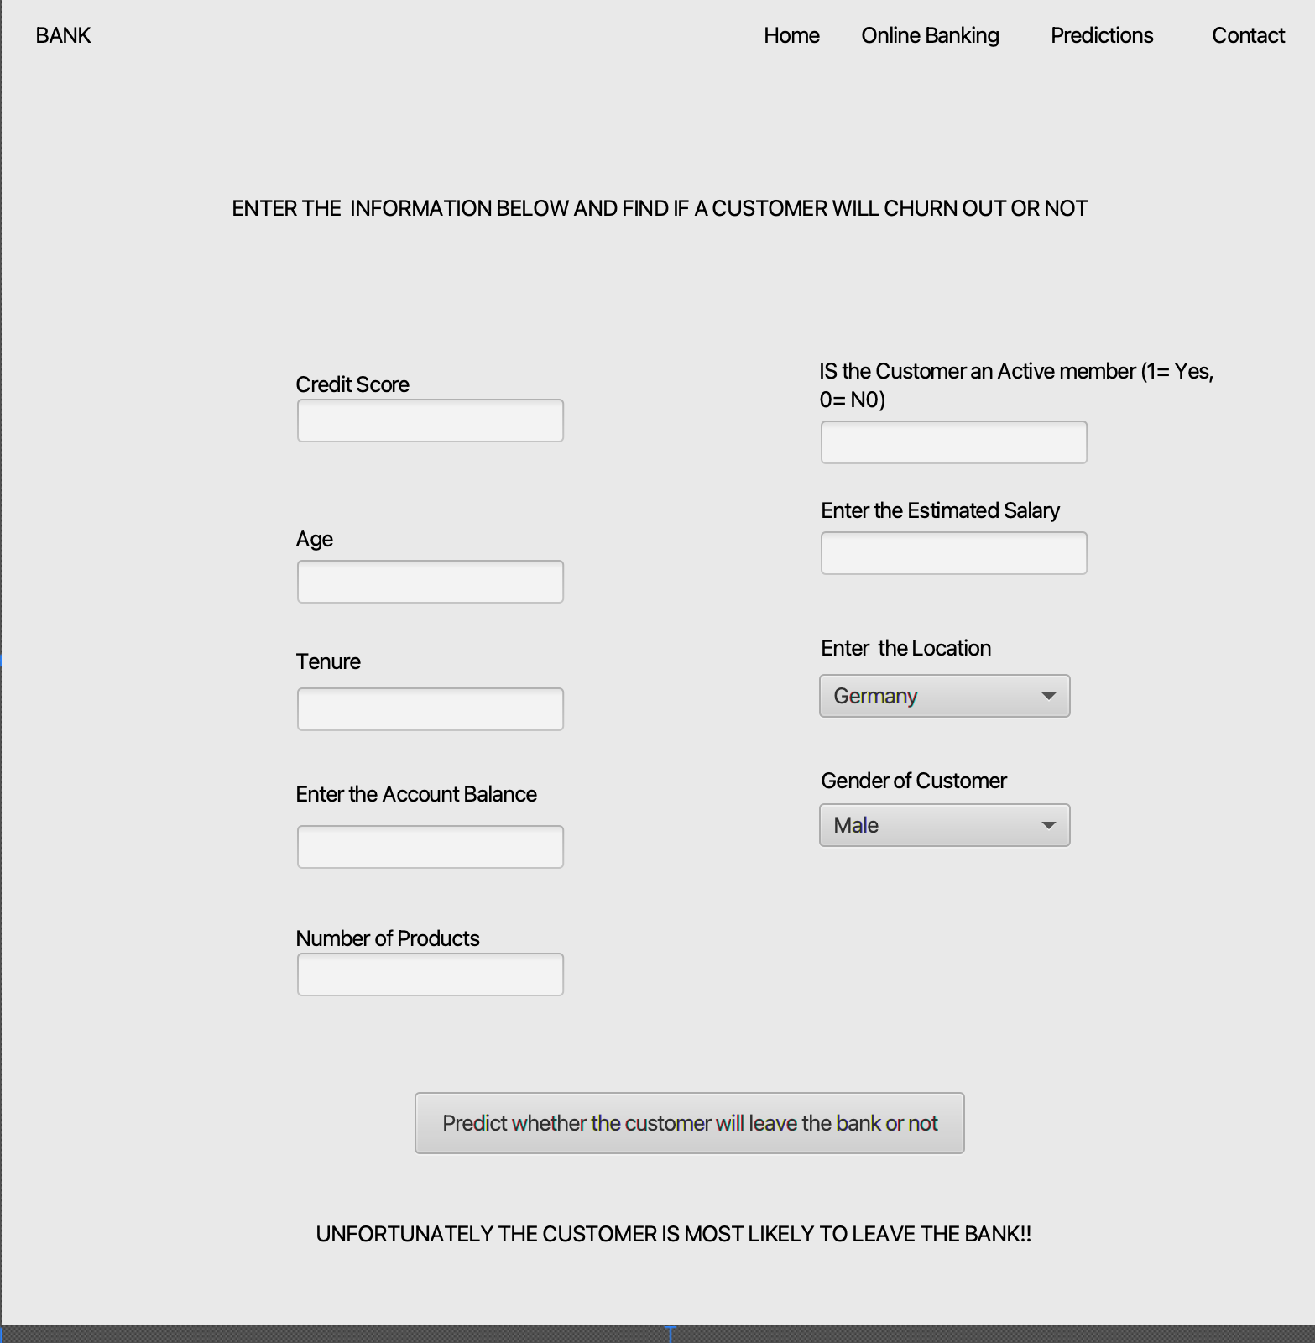
UI Mockup

Slide 20
Benchmark1
Project Understanding
Determine project objectives: first “thoroughly understand, from a project perspective.
Produce project plan: Select technologies and tools and define detailed plans for each project phase.
Benchmark2
Data Understanding
Collect initial data: download the necessary data from Kaggle and load it into jupyter lab
Describe data: Examine the data and document its surface properties like data format, number of records, or field identities.Explore data: Dig deeper into the data. Query it, visualize it, and identify relationships among the data.
Benchmark3
Data Preparaation
Select data, Determine which data sets will be used and document reasons for inclusion/exclusion.
Clean data,Construct data, and Deploy feature engineering.
Benchmark4
Modelling and Evaluation
Select modeling techniques: Determine which algorithms to try (e.g. regression, Random forest, XG Boost).
Benchmark5
Model Deployment
Plan deployment: Develop and document a plan for deploying the model.
GUI development and Integration
BenchMark
Specifications

Slide 21
Tools for data pre-processing: pandas, NumPy
Tools for Data Visualization: matplotlib, seaborn
IDE for data pre-processing, jupyter
IDE for app development , Pycharm
Tools for building GUI Languages, html and flask,
Project Management : Trello
Version Control: Git ,GitHub
Tools List

Slide 22
Benchmark1: 2.5weeks
Benchmark2: 2.5 weeks
Benchmark3 :2.5 weeks
Benchmark4: 2.5 weeks
Benchmark5: 2 weeks
Report and Presentation: 2 weeks
Time Schedule

Slide 23

Grading Scheme
Benchmark1: 18%
Benchmark2: 18%
Benchmark3 : 18%
Benchmark4: 18%
Benchmark5: 14%
Report and Presentation: 14%

Slide 24
original proposal and presentation file(s) (from CSC 520)
amendments to the proposal (approved by the project supervisor)
appropriately commented source code
documentation of project functionality (test results, screenshots, video capture of project execution, etc.)
sample output (screen shots and/or reports)
user's manual
executables and/or projects
presentation documents (used to support the presentation of the completed CSC 521 project), including any presentation file(s)
project journal: a narrative of the progress of the project, in clear, concise English, including any problems encountered and how said problems were addressed
project postmortem: a summary of what was learned from the project and (based on that experience)
discussion of how various aspects of the project might have been approached differently
a list of what areas of the proposal (if any) were not completed, including reasons why
presentation of the completed project (PowerPoint format), including screenshots of the functioning project
Deliverables

Slide 25
References
https://realpython.com/pandas-read-write-files/
https://www.datacamp.com/community/tutorials/data-preparation-with-pandashttps://www.datacamp.com/community/tutorials/data-preparation-with-pandas
https://towardsdatascience.com/introduction-to-data-visualization-in-python-89a54c97fbed
https://medium.com/codex/customer-segmentation-with-k-means-in-python-18336fb915be
https://towardsdatascience.com/data-visualization-in-data-science-5681cbdde5bf

Slide 26
Question and Answer
Prediction of Customer churn in a Bank
By Samuel Kawuma

